Slide 1

18ECE340T- MACHINE PERCEPTION WITH COGNITION
UNIT-3
Representing Textures
Reference Book
Computer and Machine Vision by E.R.Davies

Slide 2
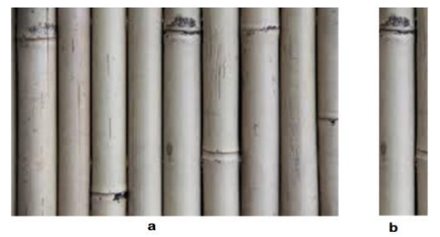
Texture
Two kinds of texture : Tactile and Optical.
where we can feel the tactile texture by touching or seeing the surface.
while the e optical or visual texture, refers to the shape and content of the image. Humans can easily diagnose the texture of the image but making a machine to analyze the texture of the image has its complexity.
In the field of image processing, we can consider the spatial changes of the brightness intensity of the pixel as the texture of the image.
In image processing, textural images are those images in which a specific pattern of texture distribution is repeated sequentially throughout the image. Thabovew image can be a representation of the textural image where part (b), represents the repeated pattern on the texture.

Slide 3
Texture
Texture Analysis
Texture Segmentation
Texture Claasification
Texture Shape
Texture Synthesis
Statistical Methods
Mode based Methods
Structural Methods
Transform based methids
Applications :
Face Recognition
Tracking objects in the videos
Diagnosis of product quality
Medical image analysis
Remote sensing
Vegetation

Slide 4
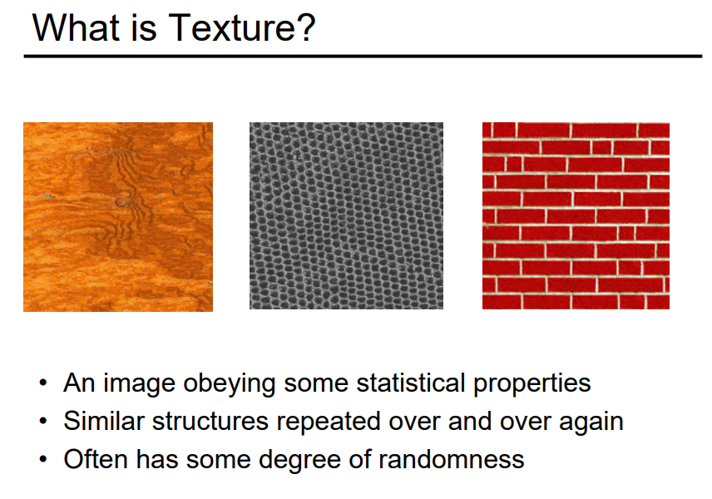
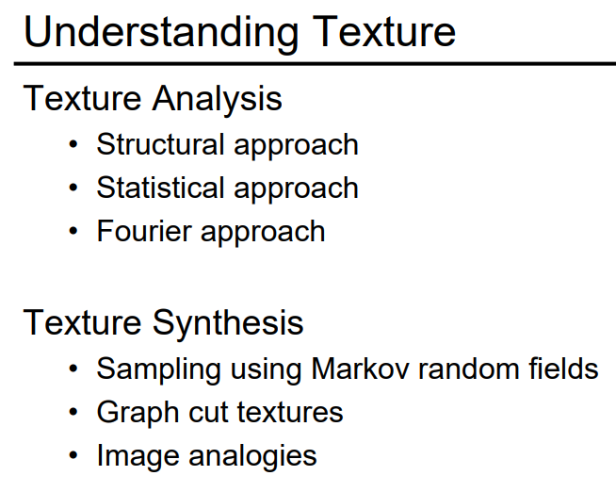
Texture

Slide 5
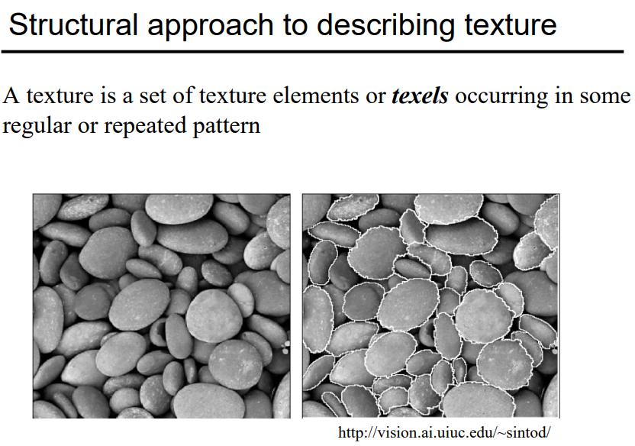
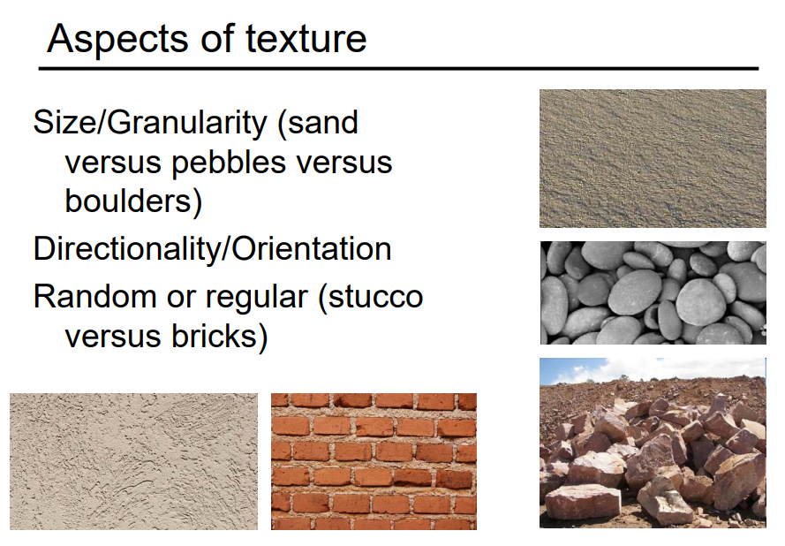
Texture

Slide 6
Representing Textures
Texture is a phenomenon that is widespread.
It is easy to recognize, and hard to define.
The effect is referred to as texture or not depends on the scale at which it is viewed.
Texture was defined as the characteristic variation in intensity of a region of an image that should allow us to recognize and describe it and to outline its boundaries.
Ex: A leaf that occupies most of an image is an object, but the foliage of a tree is a texture.
Views of large numbers of small objects are often best thought of as textures.
Examples include grass, foliage, brush, pebbles, and hair.

Slide 7
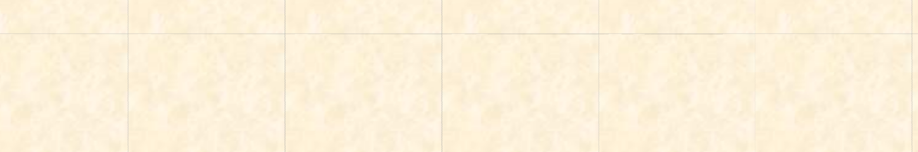

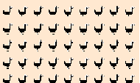





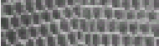

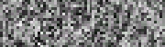
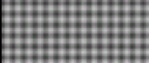
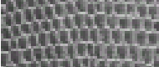

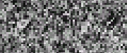
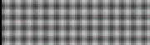
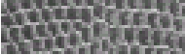

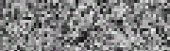
Texture Types
Definition of Texture
Texture types
Synthetic
Natural
Stochastic
< Prev
Next >

Slide 8
Texture Definition
Texture: The regular repetition of an element or pattern on a surface.
Purpose of texture analysis:
To identify different textured and non- textured regions in image.
To classify/segment different texture regions in an image.
To extract boundaries between major texture regions
To describe the texel unit.
3-D shape from texture

Slide 9
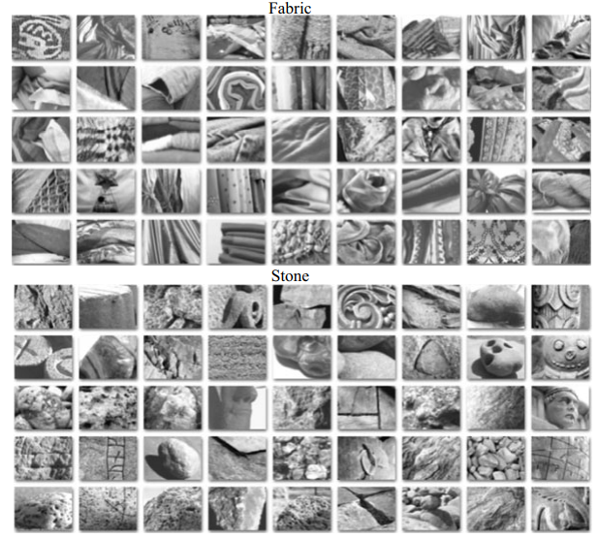
Texture
Texture is actually a very unclear concept, often attributed to human perception, as either the feel or the appearance of (woven) fabric.
Everyone has their own interpretation as to the nature of texture; there is no mathematical definition for texture.
In textile --🡪arrangement of threads.
characteristic feel - arrangement of small constituent parts, perceived structure, (of skin, rock,soil, organic tissue, literary work, etc.)
Representation of structure and detail of objects in art .

Slide 10
Texture
Texture depends not only on the input image, but also on the goal for which the image texture is used and the textural features that are extracted from the image.
Essentially, there is no unique definition of texture. There is no unique mathematical model to synthesis texture; there are many ways to describe and extract it.
Clearly, images will usually contain samples of more than one texture.
To be able to describe texture (texture descriptions are measurements which characterize a texture) and then to classify it (classification is attributing the correct class label to a set of measurements) and then perhaps to segment an image according to its texture content.

Slide 11
Texture Characterization
The texels will have various sizes and degrees of uniformity.
The texels will be orientated in various directions.
The texels will be spaced at varying distances in different directions.
The contrast will have various magnitudes and variations.
Various amounts of background may be visible between texels.
The variations composing the texture may each have varying degrees of regularity face to face randomness.

Slide 12
Texture Representation
There are three main kinds of texture representation.
1.Local texture representations
2.pooled texture representations.
3.Data-driven texture representations
Local texture representations
Local texture representations encode the texture very close to a point in an image.
These representations can’t be comprehensive, because they look at a small piece of the image.
It is very useful in image segmentation. Inside a region look similar to one another, and different from points outside the region, and segmentation algorithms need a description of the appearance close to the point to impose this requirement.
Recovering surface orientation or surface shape from an image texture is known as shape from texture.

Slide 13
Texture Representation
Pooled Texture Representation:
A texture is a set of textons that repeat in some way. Find these textons by looking for image patches that are common.
An alternative is to find sets of texton sub-elements—that is, vectors of filter outputs—that are common (if textons are repeated, then so are their subelements).
There are two important difficulties in finding image patches or vectors of filter outputs that commonly occur together.
(i) Representations of the image are continuous, cannot simply count how many times a particular pattern occurs, because each vector is slightly different.
(ii) The representation is high dimensional in either case. A patch around a pixel might need hundreds of pixels to represent it well; similarly, hundreds of different filters might be needed to represent the image at a pixel.
This means we cannot build a histogram directly, either, because it will have an unmanageable number of cells.

Slide 14
Texture Representation
Data-driven Texture Representations
Data-driven texture representations model a texture by a procedure that can generate a textured region from an example.
These representations are not appropriate for segmentation or recognition applications, but are tremendously valuable for texture synthesis.
The texture on a surface can be a strong cue to its shape. If the texture is “the same” over the surface, then deformation of the texture from point to point can be a cue to the shape of the surface.
For example, if we have a perspective view of an inclined plane with spots on it, the spots will be smaller closer to the horizon in the image. This can be used to recover the inclination of the plane.
Similarly, on a curved surface, the foreshortening of texture elements gives some information about the local inclination of the surface.
Recovering surface orientation or surface shape from an image texture is known as shape from texture;

Slide 15
Challenges in Texture Analysis
Rotation image
Noise image
Also, there can be various chances of images to differ from each other in terms of scale, viewpoint, brightness or intensity of light. – which causes challenges in texture classification.

Slide 16
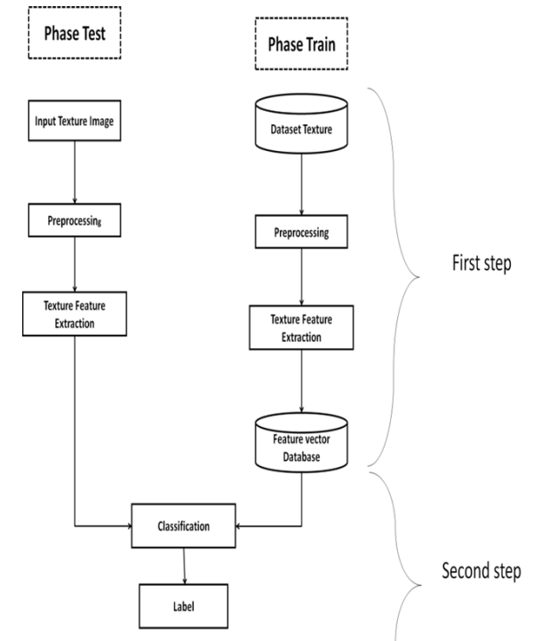
Feature Extraction Method for Categorizing Textures

Slide 17
Feature Extraction Method for Categorizing Textures
The feature extraction part:
Try to extract the textual properties of the images
The motive of this part is to make a model which can deal with every texture of the image that exists in training time.
The classification part:
In this part, we perform the texture analysis on the test images with the same techniques which we applied for the training images and apply a classification algorithm which can be a statistic or deep learning algorithm.
The images get examined by the feature extractor and then texture classification is done by the classification algorithm

Slide 18
Feature Extraction Method for Categorizing Textures
Feature Extraction
The basic idea is to extract texture features from the images, and for this procedure, it is required to have a model for every texture available in the training images.
These features can be discrete histogram, numerical, empirical distribution, and texture features such as contrast, spatial structure, direction, etc.
The extracted texture feature can be used for teaching classification. There can be various ways to classify texture and the efficiency of these ways can be dependent on the type of texture features extracted. These methods can be divided into the following groups:
Statistical methods
Structural methods
Model-based methods
Transformer methods
We can use any of the methods for extracting features from the images.

Slide 19
Feature Extraction Method for Categorizing Textures
Classification
In the second stage of the process, classification is performed on the extracted texture features based on the machine learning algorithms with classification algorithms.
Using the classification method, appropriate classes for each texture are selected.
Using the comparison between the vector of the extracted texture feature from the extraction part of the process and the vector of the selection test phase characteristics, classes are determined.
This step is repeated for every image presented.
The estimated classes for evaluation with the actual class are adapted and the recognition rate is calculated which shows the efficiency of the implemented algorithm. Normally applied accuracy measure is:
Classification accuracy = (correct matches / number of test image) ×100

